Slide 1

Module 3.B
IEC Language : ST

Slide 2
IEC Language ST
Notes:
This page intentionally blank

Slide 3
Overview
Computer language (like VBA, Pascal, ...) using a comprehensive range of constructs for assigning values to variables, calling FFBs, creating expressions for conditional evaluation, iteration or repeating selected section of code
Used to write structured logical and digital processing programs
Complies with the IEC 61131 standard
Easy to learn and use
Particularly suitable for programming complex arithmetic functions
Nested control constructs; advanced code debugging function

Slide 4
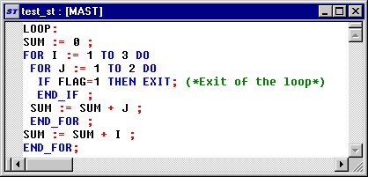
Language reference
A Structured Text program is a sequence of lines, each composed of one or more :
    Label : pinpoints a program block
    Instructions : ended by a semicolon ";"
    Comments: additional information
Loop:
IF FLAG=1 THEN EXIT ;
(*Exit of the loop*)

Slide 5
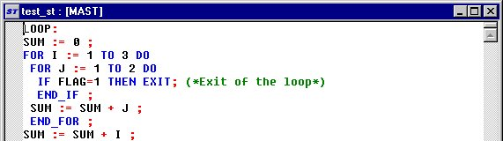
Language reference (cont'd)
Each instruction is composed of the following :
    Operator: symbol defining what operation must be performed
    Operand: the object that an operator acts upon
    Control construct
+
+
IF FLAG=1 THEN EXIT

Slide 6
Operators
These are the following basic instructions:
  Assignment (:=)
  Logical (AND, OR, XOR, NOT)
  Arithmetic (+, -, *, /, MOD, **)
  Comparison (>, <, =, >=, <=, <>)
  Function call (FUNCTIONSNAME)

Slide 7
See comments

Slide 8
See comments

Slide 9
Operands
An operand can be :
  a direct address
  a value
  a symbolic variable
  a structured data
  an element of a structured data
  an EFB/DFB output (for single type)
  an EFB/DFB call

Slide 10
Control constructs
These are the following instructions:
  IF...THEN...END_IF
  ELSE
  ELSIF...THEN
  CASE...OF...END_CASE
  FOR...TO...BY...DO...END_FOR
  WHILE...DO...END_WHILE
  REPEAT...UNTIL...END_REPEAT
  EXIT
  RETURN
  JMP

Slide 11
Comments
In the ST editor, comments always start with the string "(*" and end in the string "*)".
Between these character sequences any comments can be entered.
Nesting comments is not allowed according to IEC 61131-3. But possible if the option is selected in the project options.

Slide 12
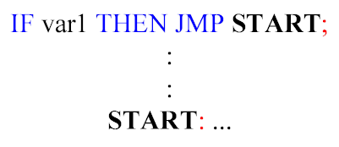
Labels
  Labels serve as destinations for Jumps.
  must always be the first element in a line
  must be unique in a section
  are not case sensitive
  can be 32 characters long (max.)
  are separated by a colon ": "
  are only permitted at the beginning of "Expressions"

Slide 13
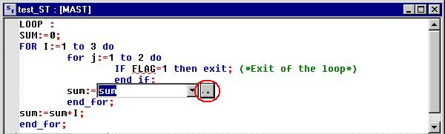
Language Editor
same aspect like a general editor (Wordpad) and complete function (copy/past, tab,...)
one or more instructions per line, separated by ";"
colors used to define the different objects
Background analysis of the entry (a syntax and semantics check carried out during program creation)
Entry help of variables, EF or FB-instances via dialog box
Notes:
Feature
Instructions must close with semicolons ";"
One line may contain several instructions, separated by ";"
A line contains a maximum of 300 characters (instruction, comment, label)
The lenght of the section is not limited
The position of labels, symbol and comments are not fixed
Search and replace of pure text or variable, FB instances
The line and column numbers of the are displayed in the status bar
Cut, copy, paste, ...
Even sections containing mistakes (i.e. wrong syntax, variable not declared, ...) may be stored
Coloring and marking
Quick info
If the cursor is placed over faulty text a Quickinfo (Tooltip) with a brief description of the cause of the error appears.

Slide 14
Specific toolbar
To insert :
  IF statement
  FOR statement
  WHILE statement
  Repeat statement
  CASE statement
To insert :
  FFB input assistant
  Comment
  Inspect window
  Subroutine
To insert :
  Font in all caps or lower case
  Increase or decrease the font

Slide 15
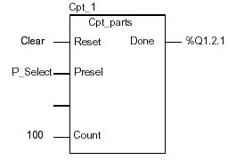
Programming rules
Variable
  entered directly or with the Data Wizard
Elementary Functions
  no required declaration
  EF used straight (without the CAL operator)
  entered directly or with the FFB Wizard
Elementary Function Blocks or Derived Function Block
  no required declaration (automatically defined with the FFB Wizard)
  EFB/DFB-instance used straight
  Formal or informal call
  entered directly or with the FFB Wizard
Cpt_1 (Reset:=Clear, Presel:=P_Select, Count:=100);
...
%Q1.2.1:=Cpt_1.Done;
Cpt_1 (Clear, %MD10, , 100);
...
%Q1.2.1:=Cpt_1.Done;
Notes:
The Elementary Functions (EF) have available operators in Structured Text do not need to be called (CAL operator not used). There are no declarations within a section, VAR and END_VAR can not be used. If a declaration is necessary, it must be done by using the Data Editor (creating an instance of a variable, EFB, ...)
An EFB/DFB-instance is automatically created if the FFB Wizard is used to add a EFB in the section.
The EFB/DFB call can be of one of two types :
. a formal call, when arguments are assignments (parameter = value). In this case, the order in which the arguments are entered in the list is not important. The EN input parameter and the ENO output parameter can be used to control the execution of the function block, Example :
Cpt_1 (Reset:=Clear, Presel:=P_Select, Count:=100, Done=>%Q1.2.1);or
Cpt_1 (Reset:=Clear, Presel:=P_Select, Count:=100);
...
%Q1.2.1:=Cpt_1.Done;
. an informal call, when arguments are values (expression, object or an immediate value). In this case, the order in which the arguments are entered in the list must follow the order of the DFB input parameters, including for non-assigned inputs (the argument is an empty field). It is not possible to use EN and ENO parameters, Example :
Cpt_1 (Clear, %MD10, , 100);
...
%Q1.2.1:=Cpt_1.Done;

Slide 16
Program development
Create or open a section in Structured Text
Write the program and edit the used variables
  Enter or select operator, control construct, ...
  Enter or select operand (variable)
  Enter or select EFB/DFB-instance
Analyze the program editing frequently to check syntax
  Any errors found displayed in the output window
  Double click on the line to go to the line with the error in ST
Save the project
Generate the project to download
Transfer and connect the project to the PLC
Debugging the program in connected

Slide 17
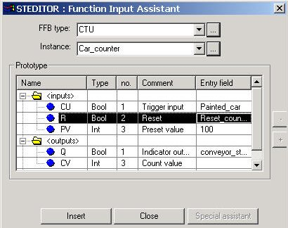
FFB input assistant
Press the assistant icon
Select the FFB by
  the type
  the instance
Note : Instance created automatically if FFB selection by the type
In Entry field, select for each input and output, the variable
Press Insert button to validate
2
3
4

Slide 18
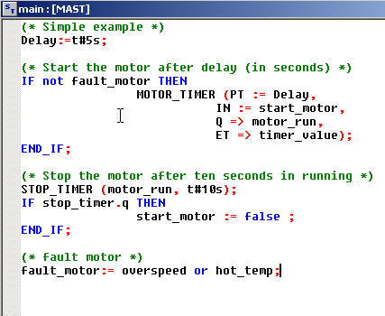
Programming example
Comment and assignment
Formal EFB call with allocation
Informal EFB call
OR-function with allocation

Slide 19
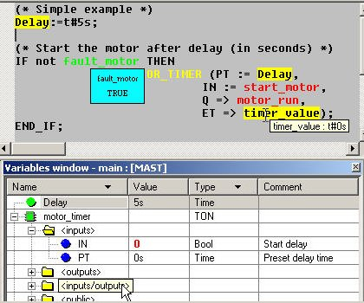
Debugging
Animation of ST section :
  Boolean variable is true :
  Boolean variable is false :
  Other variable types :
The non-boolean type are not animated in the editor but in :
  Screen tips
  Inspection windows
  Variable display window
  Animation tables
Green
Red
Yellow

